Slide 1
CMSC 426 Principles of Computer Security
Linux and Windows Authentication

Slide 2
Last Class We Covered
Authentication
Password Hashing
Password Cracking
Brute-force attacks
Dictionary attacks
Rainbow tables
Salted passwords

Slide 3
Any Questions from Last Time?

Slide 4
Today’s Topics
Linux authentication
Windows authentication
Standalone system authentication
Domain authentication
Kerberos protocol

Slide 5
Linux Authentication

Slide 6
The /etc/passwd File
Text file that stores information about user accounts
Readable by any user
On legacy UNIX systems, stored passwords hashed by the UNIX crypt() algorithm
Now a bit of a misnomer on modern Linux operating system
For each user, lists username, user ID (uid), group ID (gid), comments, home directory, preferred shell

Slide 7
UNIX crypt() Algorithm
UNIX passwords originally 8 characters max
crypt() was a legacy function used to “hash” passwords
Password used was a 56-bit key
12-bit salt
Uses a modified version of DES to make it one-way
Encrypts a 64-bit block of 0s, 25 rounds

Slide 8
The /etc/shadow File
Text file that stores password information, only readable by root
For each user, lists username, hashed password, info about password change/expiration policy
Password field actually contains 3 separate parts separated by $
ID of hashing algorithm, salt, password hash

Slide 9
Windows Authentication

Slide 10
Local Security Authority (LSA)
Windows subsystem responsible for managing authentication and local security policy
Local security policy determines:
Which users can access the system and in what way (e.g., interactively, over the network, or as a service)
Which users have which permissions on the system
What forms of auditing are being performed

Slide 11
Security Accounts Manager (SAM)
Database on standalone Windows systems that stores users’ password hashes
Two password hashing algorithms have been used
Lan Manager hash (LanMan, LM)
NT hash (NTLM)
On most modern Windows versions, the SAM file is encrypted to prevent offline password cracking
As of Windows 10, full disk encryption is preferred

Slide 12
Lan Manager Hash (LanMan, LM)
In legacy versions of Windows, passwords were 14 characters max and not case sensitive
LM hash algorithm:
Pad password to 14 characters
Convert to upper case
Split in half, use each half as a 56-bit DES key
DES encrypt the exact string “KGS!@#$%” with both keys
Concatenate the two encrypted strings

Slide 13
Lan Manager Hash Security
Trivial to brute force
Just need to crack each of the two 7-byte halves
Exponentially easier to brute-force two 7-character strings than a single 14-character string
Also, since passwords are converted to uppercase, it’s even easier to crack
Default prior to Windows NT
Disabled since Windows Vista

Slide 14
NT Hash (NTLM)
Hash used by modern Windows systems
NT Hash Algorithm:
Encode password in UTF-16 little-endian
Take the MD4 hash of the encoded password
Other info:
Longer passwords now allowed
Passwords are still not salted

Slide 15
Windows Domains
A group of computers connected over a network and managed by a central computer called a domain controller
Password hashes stored in Active Directory database
Three protocols have been used for authentication between a client and a server on a domain
NTLMv1 Protocol
NTLMv2 Protocol
Kerberos

Slide 16
NTLMv1 Authentication Protocol
Server issues a random 8-byte challenge to the client
Client computes both the LM and NT hashes of the password
Each 16-byte hash is padded to 21 bytes using 5 null bytes
Both 21-byte values are separated into three 7-byte (56-bit) blocks
Each block is DES encrypted using the challenge as a key, then all are appended together into a 48-byte response
The server computes this as well and validates the response
Insecure due to use of LM hash and DES

Slide 17
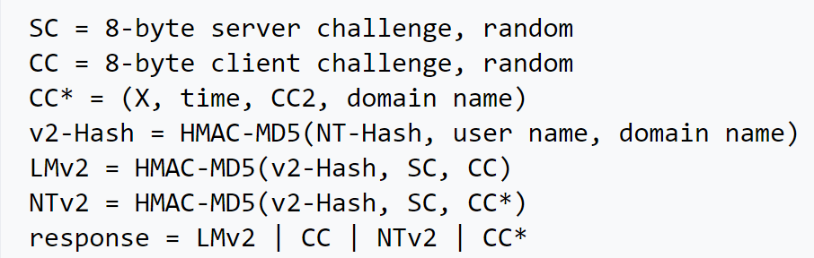
NTLMv2 Authentication Protocol
Server issues a random 8-byte challenge to the client
Client sends two responses containing information such as a random 8-byte value, the current time, the NT hash of the password, the user name, and the name of the domain
Server validates responses
Notes:
https://en.wikipedia.org/wiki/NT_LAN_Manager#NTLMv2
Can’t fit it on the slide

Slide 18
Kerberos Protocol

Slide 19
Kerberos Protocol
Leading standard protocol for remote authentication
Used by many OSes, not just Windows
Will mostly be talking about it in the context of Windows domains
Manages client-server interactions using a Key Distribution Center (KDC)
Key Distribution Center provides two services:
Authentication Service (AS)
Ticket-Granting Service (TGS)

Slide 20
Kerberos Protocol
Windows Domain
Each time the client logs into a domain, they send their user ID and request for a Ticket-Granting Ticket (TGT) to the AS
Key Distribution Center (KDC)
Authentication Server (AS)
Client
Ticket Granting Server (TGS)
Server

Slide 21
Kerberos Protocol
Windows Domain
The AS responds with two messages:
The TGT, which contains the user’s ID, TGS ID, timestamp, IP address, lifetime, and TGS session key, encrypted using the TGS secret key
The TGS ID, timestamp, lifetime, and TGS session key, encrypted using the client’s password hash as a key
Key Distribution Center (KDC)
Authentication Server (AS)
Client
Ticket Granting Server (TGS)
Server

Slide 22
Kerberos Protocol
Windows Domain
The user enters their password and decrypts the second message
The client prepares an Authenticator, which contains their user ID and timestamp, and encrypts it using the TGS session key
Key Distribution Center (KDC)
Authentication Server (AS)
Client
Ticket Granting Server (TGS)
Server

Slide 23
Kerberos Protocol
Windows Domain
Any time the client needs to communicate with a server, it sends a message to the TGS requesting a ticket to the server
The client also sends the encrypted TGT and encrypted Authenticator to the TGS
Key Distribution Center (KDC)
Authentication Server (AS)
Client
Ticket Granting Server (TGS)
Server

Slide 24
Kerberos Protocol
Windows Domain
The TGS decrypts the TGT with its secret key
The decrypted TGT contains the TGS session key, which the TGS uses to decrypt the Authenticator
The TGS validates all information
Key Distribution Center (KDC)
Authentication Server (AS)
Client
Ticket Granting Server (TGS)
Server

Slide 25
Kerberos Protocol
Windows Domain
The TGS sends two messages to the client:
A service ticket that contains the user’s ID, the service’s ID, IP address, timestamp, lifetime, and service session key, all encrypted using the service secret key
The service’s ID, timestamp, lifetime, and service session key, encrypted using the TGS session key
Key Distribution Center (KDC)
Authentication Server (AS)
Client
Ticket Granting Server (TGS)
Server

Slide 26
Kerberos Protocol
Windows Domain
The client decrypts the second message using the TGS session key
The client prepares a second Authenticator that contains the user’s ID and timestamp and is encrypted using the service session key
Key Distribution Center (KDC)
Authentication Server (AS)
Client
Ticket Granting Server (TGS)
Server

Slide 27
Kerberos Protocol
Windows Domain
The client sends the service ticket and the second Authenticator to the server
Key Distribution Center (KDC)
Authentication Server (AS)
Client
Ticket Granting Server (TGS)
Server

Slide 28
Kerberos Protocol
Windows Domain
The server uses its secret key to decrypt the service ticket, which includes the service session key
The server decrypts the second Authenticator with the service session key
The server validates all information
Key Distribution Center (KDC)
Authentication Server (AS)
Client
Ticket Granting Server (TGS)
Server

Slide 29
Kerberos Protocol
Windows Domain
The server prepares a third Authenticator containing the server’s ID and the timestamp, and encrypts it with the service session key
The server sends its Authenticator to the client, which decrypts it
Authentication complete!!!
Key Distribution Center (KDC)
Authentication Server (AS)
Client
Ticket Granting Server (TGS)
Server

Slide 30
Announcements
Next class will be Hardening
Topic will NOT be on the upcoming exam
Go vote!!!
Midterm 2 is happening on Thursday (November 8th)

